Slide 1


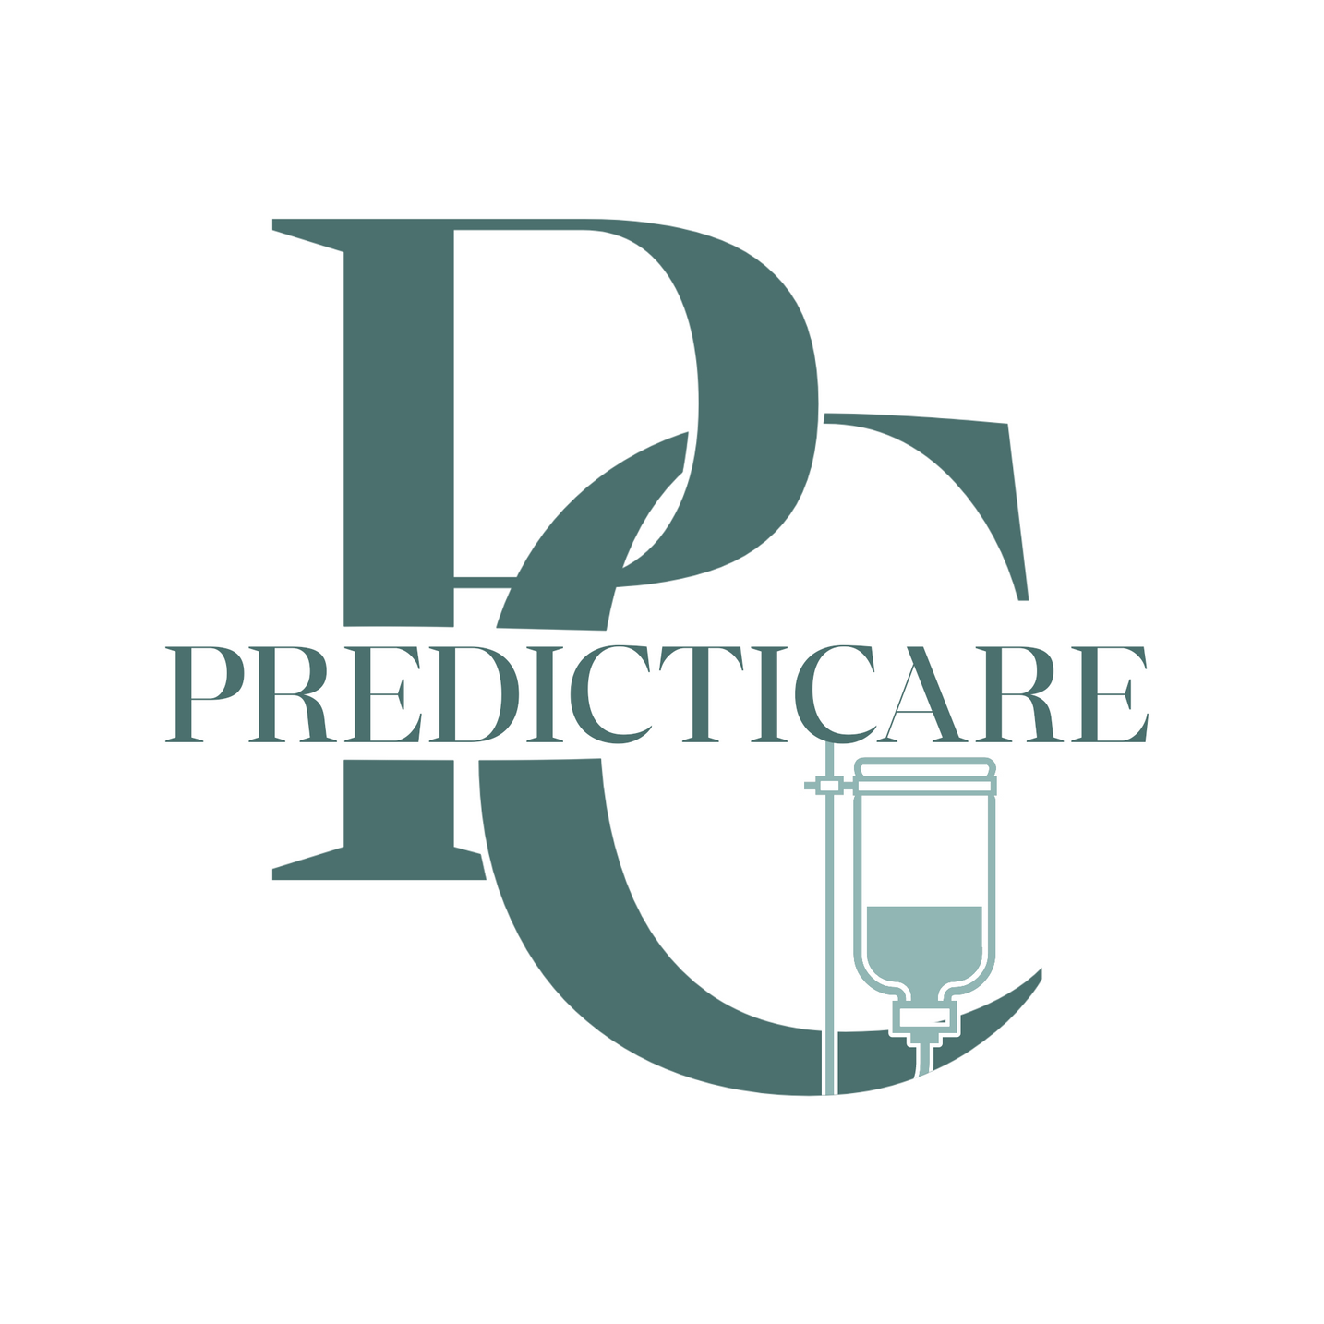
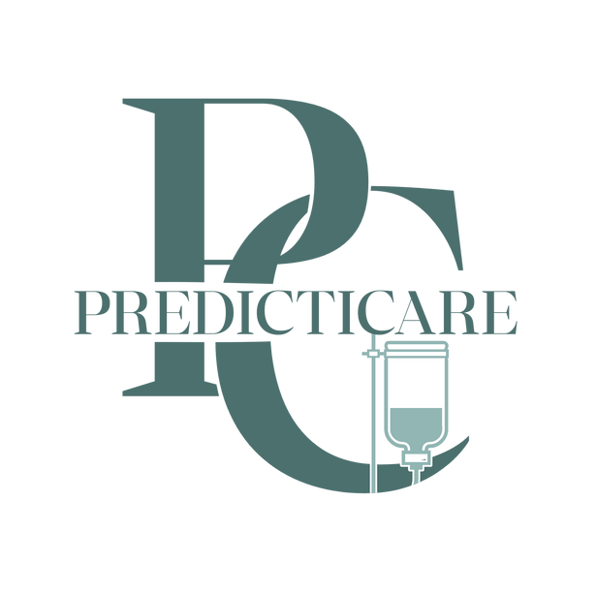



PREDICTICARE
CARE WITH PREDICTIVE PRECISION

Slide 2




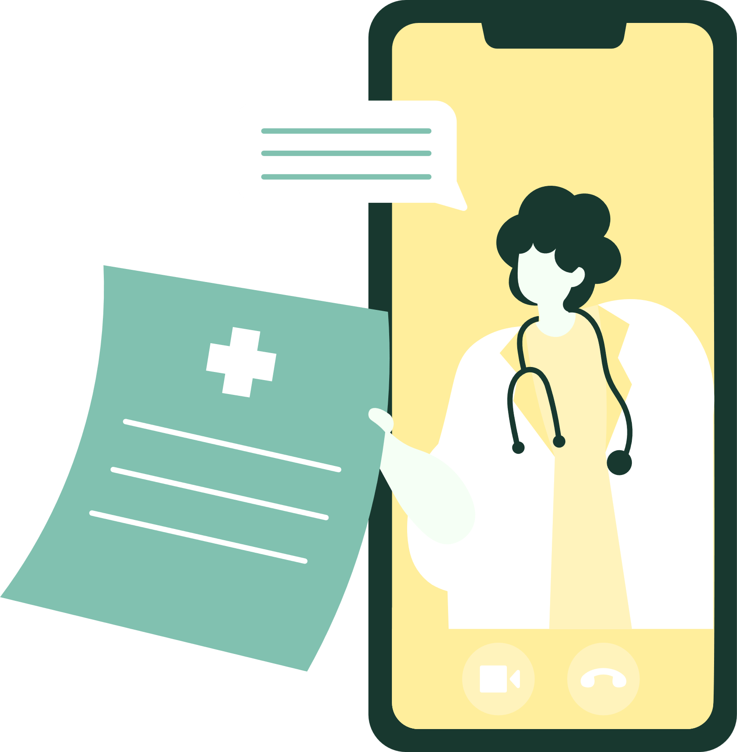
ABOUT US
PredictiCare offers to assist you in diagnosing your illness, with the help of AI. With provided data sets inside of our system and will be generated by machine learning— a user can diagnose themselves without having the need to visit the clinic.

Slide 3







OBJECTIVES
Accessibility:
Providing an accessible and user-friendly interface for users.
Early Illness Detection and Prevention:
Aiding users in order for them to prevent a more serious illness.
Convenient and Hassle-Free Diagnostic Procedures:
Reducing the need of users for unnecessary clinic visits.

Slide 4



SIGNIFICANCE OF THE STUDY
For the people of PHINMA-University of Iloilo
This system aims to prioritize students, faculties and other staff's wellbeing and health. This can help them monitor their health and prevent any serious illnesses.
For the people outside of the University
This system will aid people outside of the University to predict and prevent their illness before a more serious illnesses could affect them.

Slide 5

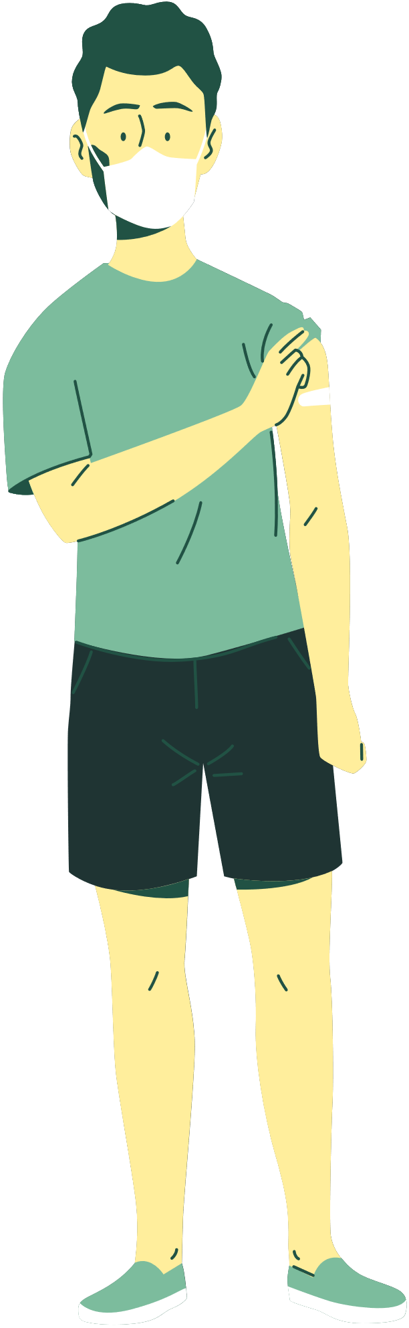



TARGET AUDIENCE
Individuals Seeking Health Information
Hospitals and Clinics
Medical Professionals
The system will act as a first aid kit for patients, before the medical professionals give prescriptions.
The system will support them in monitoring the patients with recorded data and with the help of machine learning.
The system aids individuals who want to find out their illness when they don't have time to visit a clinic or hospital.

Slide 6


END OF THE PRESENTATION.
THANK YOU SO MUCH!

